Slide 1
CptS 327
Cloud Infrastructure and Virtualization
Notes:
Template-WSU Hrz 201.ppt

Slide 2
Today’s Topics
What is cloud computing?
Cloud Infrastructure
  Components
  Architectures
  Delivery models
Virtualization
  Hypervisors
  Provisioning
  Virtualization vs Containerization
Notes:
Template-WSU Hrz 201.ppt

Slide 3
Cloud Computing
Traditional computing
  Local hosts run everything
  Not heavy on networks
Cloud computing
  Remote devices run most services
  Local hosts connect to remote devices
  Network-based
Advantages of cloud computing
  Central management
    Easier administration of controlled equipment
  Shift redundancy burden from end user to central admin
  Continuous integration and delivery
Notes:
Template-WSU Hrz 201.ppt

Slide 4
Cloud Computing
Disadvantages of cloud computing
  Networks can be a single point failure
    Increased vulnerability to network-based attacks
    Outage of networks can cripple a cloud-based company
Modern practices
  Cloud computing is popular
  Critical infrastructure companies have traditional backups
  Casual users do not worry about traditional backups
    Consensus identifies this as a deficiency
Notes:
Template-WSU Hrz 201.ppt

Slide 5
Cloud Components
Network
  Need a network backbone and client-facing DNS sockets
  Core and edge devices
Compute Servers
  Main brainpower of the cloud
  Enables remote compute (apps, programs, scripts, data processing)
Storage
  Main memory of the cloud
  Enables scalable data collection and retainment
Notes:
Template-WSU Hrz 201.ppt

Slide 6
Cloud Components
Software
  Operating systems
  Firmware and other middleware items
  User applications
Virtualization
  A powerful server can be made to host multiple nodes
    Each node is an operating system of its own
  Usually requires a hypervisor
    Unless the virtualization is simply running containers
      Containers are packages for individual apps
  Not required but increasingly popular
Notes:
Template-WSU Hrz 201.ppt

Slide 7
Cloud Architectures
Private cloud
  Remote devices setup and managed for one organization
  Can be self-developed or contracted
    If contracted
      Ensure dedicated equipment; used for only one organization
Public cloud
  Remote devices setup and managed for general public use
    Public still needs to pay a fee to use
      Multi-tenant environment models can decrease fees
        But has privacy and performance issues
Hybrid cloud
  Mix of private and public
    Used by several tech companies
Notes:
Template-WSU Hrz 201.ppt

Slide 8
Cloud Sub Architectures
Community Cloud
  Public cloud, but limited to one community
Distributed Cloud
  Cloud components are spread across a wide geographic location
MultiCloud
  Cloud deployed for various services
PolyCloud
  Multiple public clouds; each tailored for specific services
Big Data Cloud
  Cloud specifically tailored for large scale data processing or mining
HPC Cloud
  Cloud specifically tailored for numerous intense computations
…
Notes:
Template-WSU Hrz 201.ppt

Slide 9
Cloud Delivery Models
IaaS: Infrastructure as a Service
  Cloud service provider delivers
    Networking
    Data Storage
    Servers (compute)
    Virtualization capacities
  Customer or client is expected to provide
    Operating system licenses
    Software licenses
    Middleware
    User apps
    Data for computation
Notes:
Template-WSU Hrz 201.ppt

Slide 10
Cloud Delivery Models
PaaS: Platform as a Service
  Cloud service provider delivers
    Networking
    Data Storage
    Servers (compute)
    Virtualization capacities
    Operating system licenses
    Software licenses
    Middleware
    User apps
  Customer or client is expected to provide
    Data for computation
    Custom user apps
Notes:
Template-WSU Hrz 201.ppt

Slide 11
Cloud Delivery Models
SaaS: Software as a Service
  Cloud service provider delivers
    Networking
    Data Storage
    Servers (compute)
    Virtualization capacities
    Operating system licenses
    Software licenses
    Middleware
    User apps
    Data for computation
  Customer or client is expected to provide
    Usually nothing but can install custom user apps
Notes:
Template-WSU Hrz 201.ppt

Slide 12
Cloud Delivery Sub Models
MBaaS: Mobile Backend as a Service
  SaaS but tailored for end users of mobile and web apps
FaaS: Function as a Service
  SaaS but billing is on minute or hour basis rather than per node/cluster/VM
    Useful for low-use operations
    Not efficient for high-use operations
Notes:
Template-WSU Hrz 201.ppt

Slide 13
Multipurpose Cloud Providers
These providers offer IaaS, PaaS, and SaaS delivery models
  Amazon Web Services (AWS)
  Microsoft (Azure)
  Google Cloud Platform (GCP)
  Alibaba Cloud
  Oracle Cloud
  IBM Cloud
  Tencent Cloud
  …
Notes:
Template-WSU Hrz 201.ppt

Slide 14
Single Purpose Cloud Providers
There are popular providers for specific applications or services
  SIEM (Splunk and Elastic Search, …)
  Data (OneDrive, GoogleDrive, …)
  Anti-malware (Malwarebytes, Sophos, …)
  Streaming (YouTube, Twitch, …)
  Gaming (Xbox Cloud, Stadia, …)
  …
Notes:
Template-WSU Hrz 201.ppt

Slide 15
Virtualization (v12n)
Creating virtual version of a computing component
  Most computing components can be virtualized
Two umbrellas
  Hardware Virtualization
  Terminal Virtualization
Types of virtualization all fall under the two umbrellas
  Terminal: App, workspace, service, data or D/B v12n, …
  Hardware: Processors, memory, network, I/O v12n, …
Key aspects
  Hypervisor
  Provisioning
  Snapshot and Migration
  Failover
  Nesting
  Licensing
Notes:
Template-WSU Hrz 201.ppt

Slide 16
Hypervisors
AKA Virtual Machine Monitors (VMMs) or Virtualizers
  Creates control programs required for virtual machine (VM) functioning
    Host: device which runs the hypervisor
    VM or Virtual Machine: guest virtualized by the hypervisor
All guests share the same underlying physical capabilities
  Can’t run a 64-bit VM on a 32-bit processor
Two types
  Type-1 / Native / Bare-Metal
    Hypers run directly on host hardware
      E.g.: VMWare ESXi, Citrix XenServer, MS Hyper-V, …
  Type-2 / Hosted
    Hypers run on a host OS
      E.g.: Oracle VirtualBox, VMWare Workstation, …
Hyperjacking
  Hijacking the hypervisor of a host, could be malicious or benign
Notes:
Template-WSU Hrz 201.ppt

Slide 17
Provisioning
Components provided to a guest by the host
  Network
    Intranet
    Internet
  Processing
  Storage
  Data
  User
Provisioning is usually divided into two categories
  Thin-provisioned
    Guest expected to bring nothing but connectivity to the host
  Thick-provisioned
    Guest expected to bring one or more components
Modern trends are moving towards thin-provisioned virtualization
Notes:
Template-WSU Hrz 201.ppt

Slide 18
Snapshot and Migration
Snapshots
  Save the verbatim state of a guest/VM at a given point in time
    Files, processes, users, network flows, …
  Can take multiple snapshots
    Theoretically: no limit
    Practically: limited by host hardware
Migrations
  Popular: moving snapshots from one hyper to another hyper
  Formal: moving a guest from one host to another host
  Considerations for a smooth migration
    Ensure destination host is similar if not identical to source host
      What if not?
        Compatibility issues
        Memory issues
        Network issues
Notes:
Template-WSU Hrz 201.ppt

Slide 19
Failover
Automatic migration settings for hosts
A failover program will auto migrate all guests from one host to another if
  Host triggers failing state signs such as
    Memory segmentation faults
    Network faults
    File corrupts
    Process delays
    …
State terminology
  Current state
  Last-known coherent state
  Corrupt states
  Unknown state
Notes:
Template-WSU Hrz 201.ppt

Slide 20
Nesting and Licensing
Nesting
  Theoretically: a guest can host a guest, which can in turn host a guest…
  Practically: limited by provisioning and underlying hardware
Licensing
  Guest and host machines are all bound by licensing
    Some hosts cannot virtualize certain guests
      macOS guests legal to be virtualized only on Apple hosts
    *Nix hosts are free but need a license to virtualize Windows guests
  Some hypervisors are also licensed
  Licensing crackdowns are severe at corporate level
    One mistake can cause millions of damage in lawsuits
      E.g.: new grad uses old university license for corporate VMs
        Telemetry is real
Notes:
Template-WSU Hrz 201.ppt

Slide 21
Hardware Virtualization
How are hardware components treated in a guest?
Full Virtualization
  Each guest has its own simulated set of hardware
    Guests can operate unmodified as if running on a separate computer
Para Virtualization
  All guests operate on one set of simulated hardware
    Guests would need mods / compatch to work
Hardware-assisted virtualization
  Works for either type of hardware v12n
  Host native hardware helps execute instructions
    Instructions can be processing, memory, network, I/O,…
    Risk: host-native vulnerabilities pass into guests
Notes:
Template-WSU Hrz 201.ppt

Slide 22
Terminal Virtualization
AKA Desktop Virtualization
Host runs one OS, allows multiple guest terminals
Each guest will experience the terminal as if they were on a dedicated computer
Multi-seat
  One guest can initiate multiple sessions
    E.g.: User A logs in using a session each on laptops, phones, tablets, …
Single-seat
  One guest can initiate one session
    E.g.: User A can only log in using one device at a time
Either Terminal or Hardware virtualization works well with Cloud Infrastructure
  Some Cloud services specialize in Terminal or Hardware
  While others specialize in both
Notes:
Template-WSU Hrz 201.ppt

Slide 23
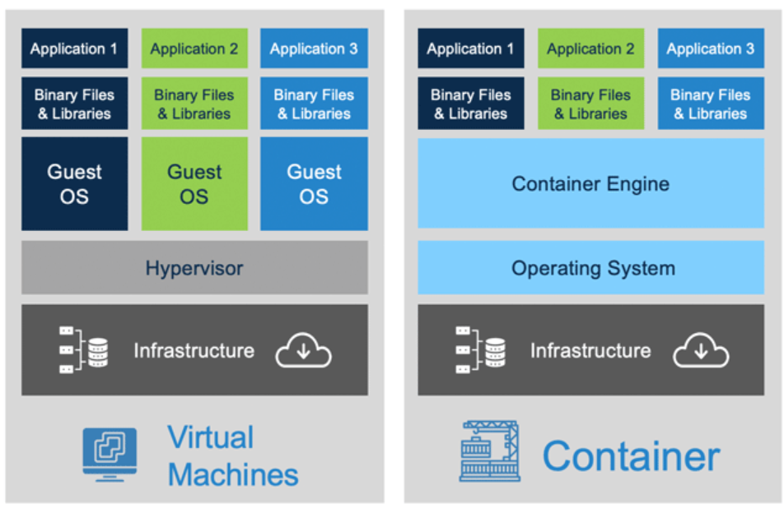
Virtualization VS Containerization
  Containerization is AKA OS-level virtualization; a subtype of Terminal Virtualization
Notes:
Template-WSU Hrz 201.ppt

Slide 24
Any questions?
Notes:
Template-WSU Hrz 201.ppt

